Slide 1
Payment Management System (KNUPay)
Capstone Project Design 1
Zofia Matyjewska
Dorota Wojciechowicz
Joseph Byrne
Thomas Cimon
Soliev Abduvosit

Slide 2

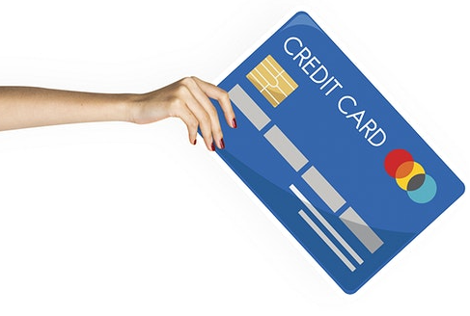
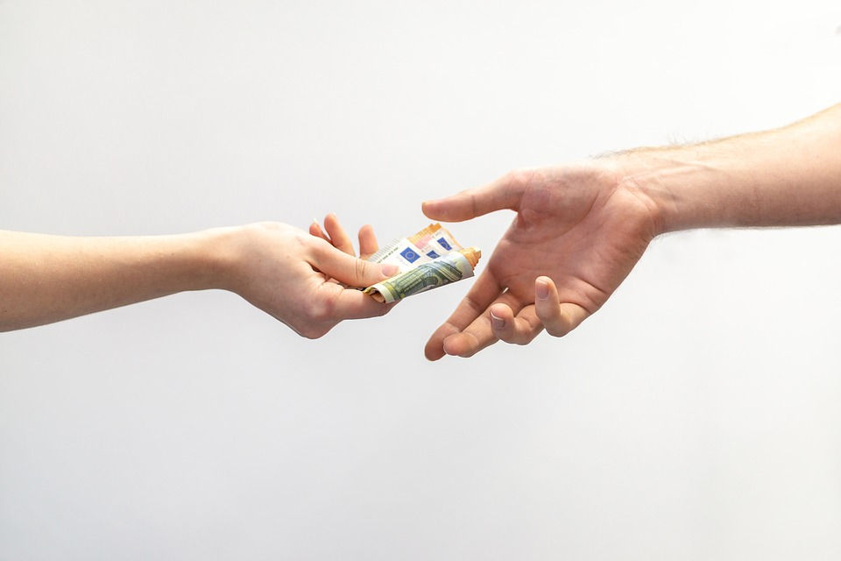
Motivation for the project

Slide 3

Our Application – main goal
making quick cashless payments using NFC technology

Slide 4



KNUpay
KNUcoin

Slide 5
How will it work?
Creating user account
Logging in to the application
Managing your own money
Making and receiving transfers
Closing the apllication transfers
Logging out

Slide 6

Project requirements
NFC technology
Backend and frontend implementation
Database usage
User-friendly interface
Good team communication
Clean code

Slide 7






Tools

Slide 8
THE END!

